Slide 1

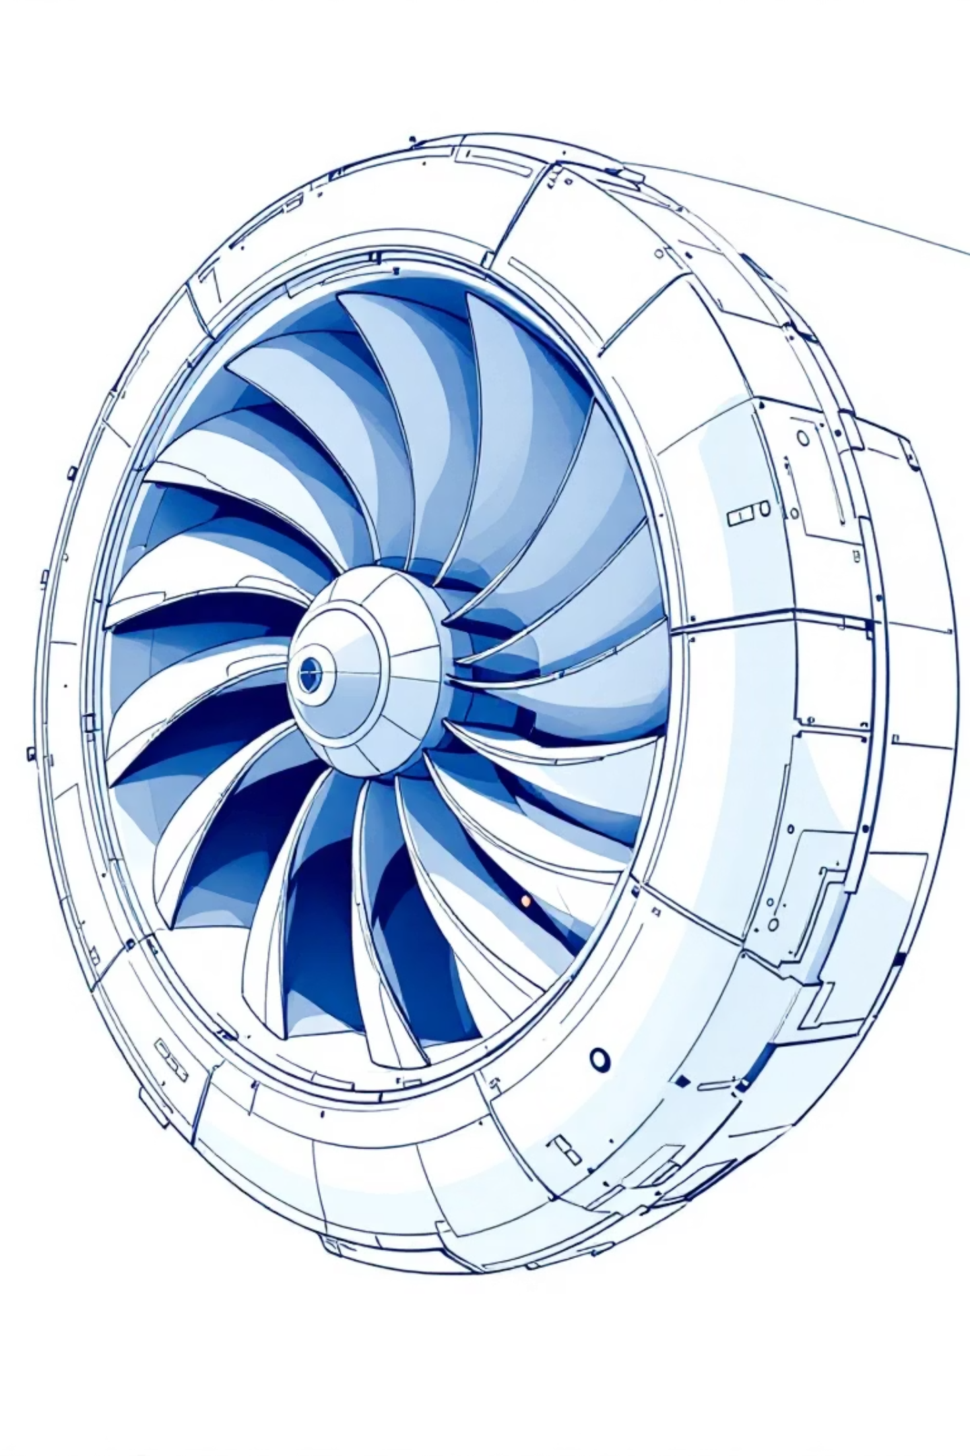
Predictive Maintenance on Turbofan Engines
Group Members: Kishan Cheeramath, Dalmy John, Tomson Roy, Adithye Mathew

Slide 2




Project Overview
LSTM Model Development
Historical Sensor Analysis
RUL Prediction
Building a Long Short-Term Memory neural network specifically designed for aircraft turbo engine predictive maintenance applications.
Leveraging comprehensive historical engine sensor data to build an advanced condition monitoring system that tracks engine health in real-time.
Accurately predicts the remaining useful life (RUL) of engines, enabling early maintenance scheduling to prevent unexpected failures and optimize operations.

Slide 3
Dataset Specifications
Engine Identification
Operational Settings
Engine ID (Column 1): Unique identifier for each engine unit (1–100)
Three key parameters (Columns 3–5):
Altitude conditions during operation
Time Cycle (Column 2): Current operational cycle number tracking engine usage
Mach number (flight speed)
Throttle resolver angle (TRA)
Sensor Measurements
21 comprehensive sensors (Columns 6–26):
Temperature sensors: T2, T24, T30, T50
Pressure sensors: P2, P15, P30, Ps30
Fan speed (Nf) and Core speed (Nc)
Additional performance indicators

Slide 4
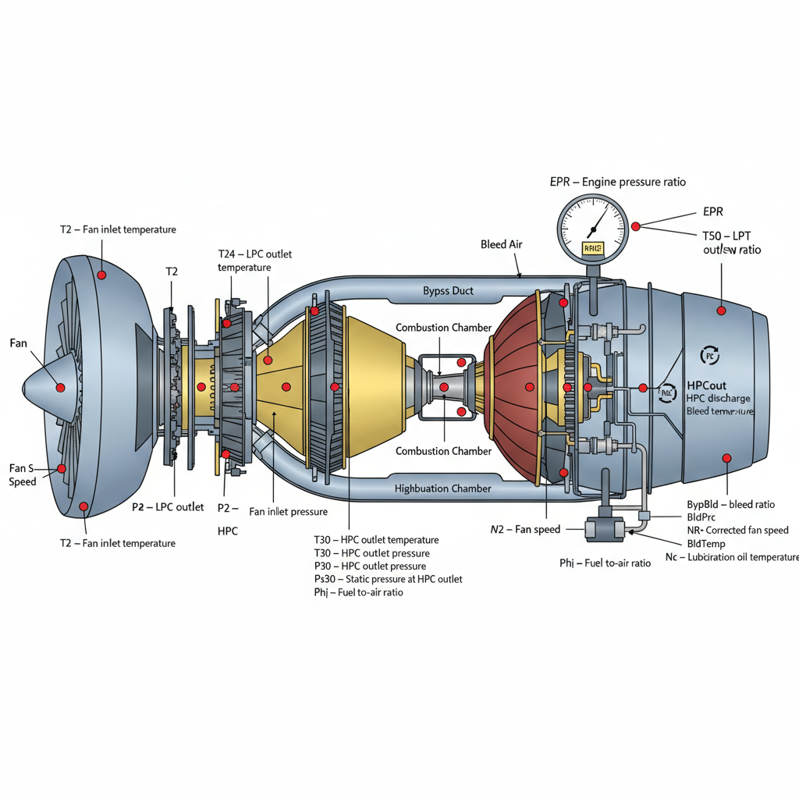
Sensors
1. T2 – Fan inlet temperature
2. T24 – LPC outlet temperature
3. T30 – HPC outlet temperature
4. T50 – LPT outlet temperature
5. P2 – Fan inlet pressure
6. P15 – Bypass-duct pressure
7. P30 – HPC outlet pressure
8. Nf – Fan speed
9. Nc – Core speed
10. EPR – Engine pressure ratio
11. Ps30 – Static pressure at HPC outlet
12. Phi – Fuel-to-air ratio
13. NRf – Corrected fan speed
14. NRc – Corrected core speed
15. BypBld – Bypass bleed ratio
16. BldPrc – Bleed pressure
17. BldTemp – Bleed temperature
18. HPCout – HPC discharge pressure
19. FanInletTemp – Duplicate of T2
20. FuelFlow – Fuel flow rate
21. OilTemp – Lubrication oil temperature

Slide 5
Why Vibration Sensors Are Not Included in C-MAPSS
• C-MAPSS is a simulation dataset, not real engine data — it models gas-path performance, not mechanical vibration.
• Focuses on gradual thermodynamic degradation (e.g., compressor/turbine wear), not mechanical faults (bearings, imbalance).
• Vibration data requires high-frequency (kHz) sampling, while C-MAPSS records per flight cycle (low frequency).
• The goal is RUL prediction from flight-level data available via aircraft FADEC sensors — which typically exclude vibration.
• For vibration-based fault detection, NASA provides separate datasets (e.g., IMS Bearing, PHM 2012 Challenge).

Slide 6

Phase 2: Development Progress
01
Data Loading & Labeling
Successfully loaded the turbofan engine dataset and integrated appropriate column labels for all sensor readings and operational parameters.
02
Data Preprocessing
Completed comprehensive data preprocessing including generation of classification target variables and normalization of all sensor measurements to ensure model accuracy.
03
Exploratory Data Analysis
Conducted thorough EDA to understand sensor behavior patterns, data distributions, and correlations across different engine operational cycles.
04
Visualization & Documentation
Generated detailed sensor value plots for multiple engine IDs and maintained comprehensive GitHub repository with all datasets and technical documentation.

Slide 7

Industrial Problem Addressed
Current Challenges
LSTM Solution Benefits
Over-Maintenance Issues:
Advanced Pattern Recognition:
Unnecessary part replacements driving up operational costs
Handles complex sequential time-series sensor data effectively
Wasted resources on premature component changes
Learns degradation patterns beyond simple threshold rules
Reduced aircraft availability due to scheduled downtime
Predicts remaining useful life with superior accuracy
Under-Maintenance Risks:
Proactive Maintenance:
Unexpected engine breakdowns creating safety hazards
Early detection of potential issues before critical failure
Unplanned events costing 3-5x more than scheduled maintenance
Optimized resource allocation and maintenance scheduling
Rush repairs requiring premium labor and expedited parts
Enhanced safety through predictive intervention

Slide 8
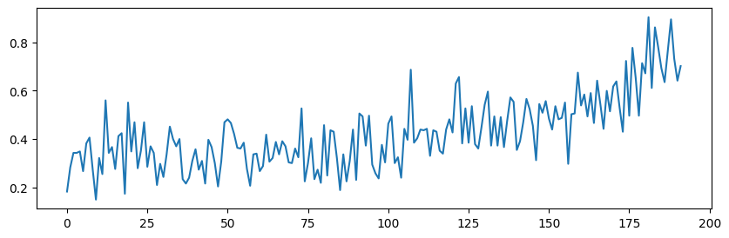
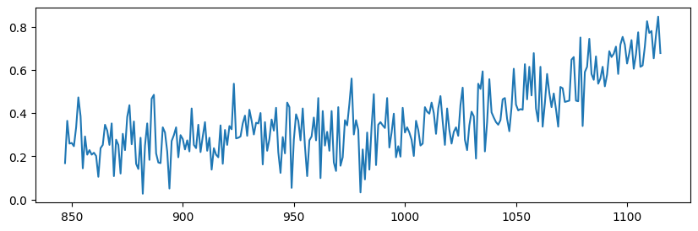
Exploratory Data Analysis
Sensor 2 Behavior Across Engine Lifecycles

Slide 9
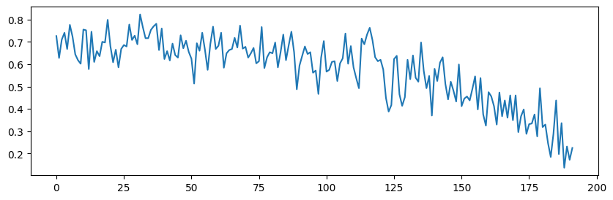
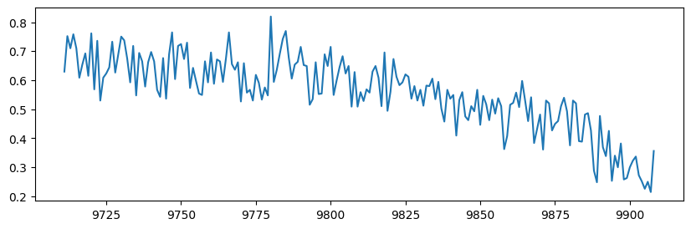
Sensor 6 Degradation Patterns

Slide 10





Next Steps & Deliverables
Generate Input Sequences
Create time-windowed sequences from sensor data to prepare training inputs for the LSTM architecture.
LSTM Training & Testing
Train the LSTM model on historical data and validate performance using test dataset with known failure points.
Model Comparison
Benchmark LSTM performance against alternative neural network architectures to validate approach effectiveness.
Repository Update
Upload comprehensive reports, processed datasets, and finalized code to the team GitHub repository for stakeholder review.

